Slide 1
Module 2: Behavioral Design Patterns
BDP: Behavioural design patterns focus on how objects communicate and interact with each other.
They define how responsibilities and algorithms are distributed among objects.
They help make communication between objects: Flexible; Maintainable; Loosely coupled; Easier to extend.
Major Behavioral Patterns:
  1. Template Method Pattern
  2. Chain of Responsibility Pattern
  3. State Pattern
  4. Command Pattern
  5. Observer Pattern
Key idea: Behavioural patterns focus on object communication and behavior, rather than object creation or structural organization.
1

Slide 2
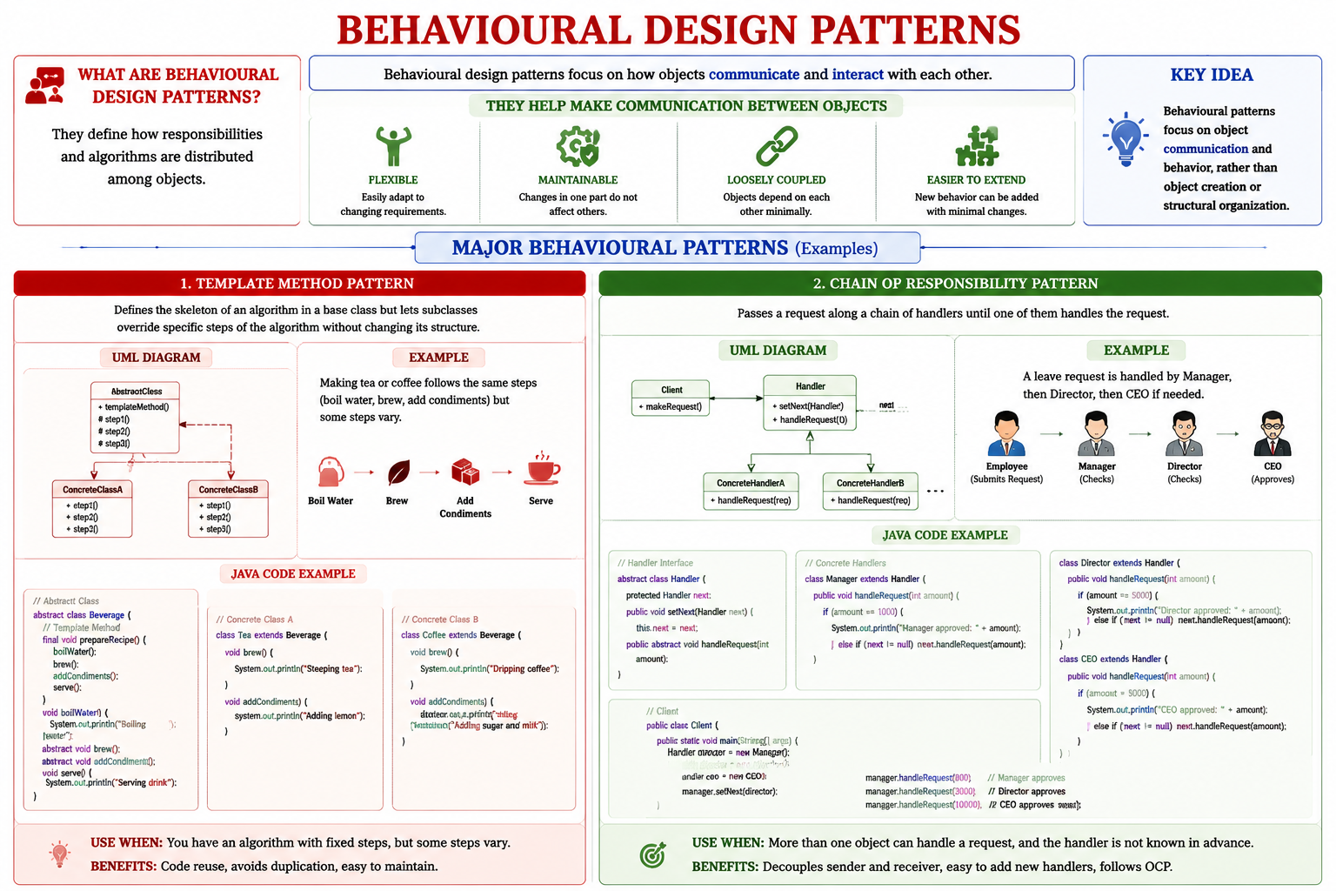
Module 2: Behavioural Design Patterns
1

Slide 3
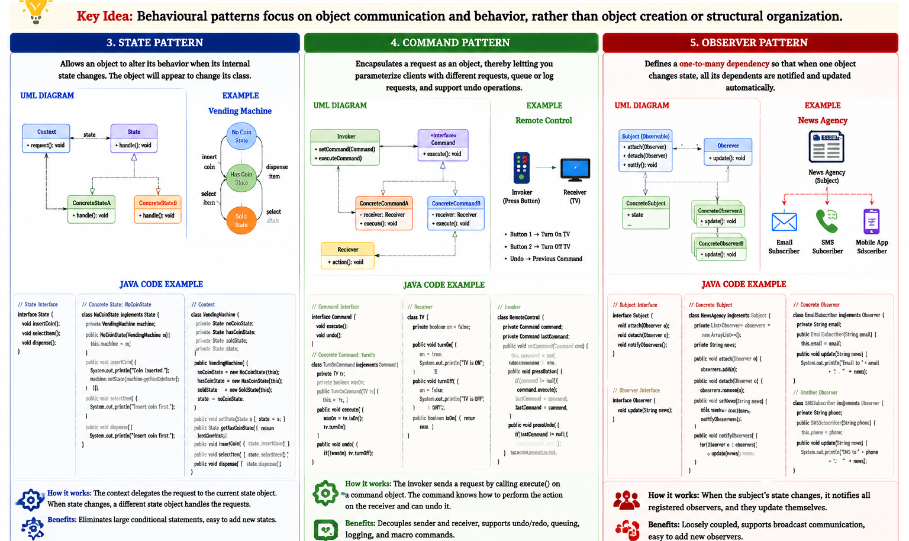
Module 2: Behavioural Design Patterns
1

Slide 4
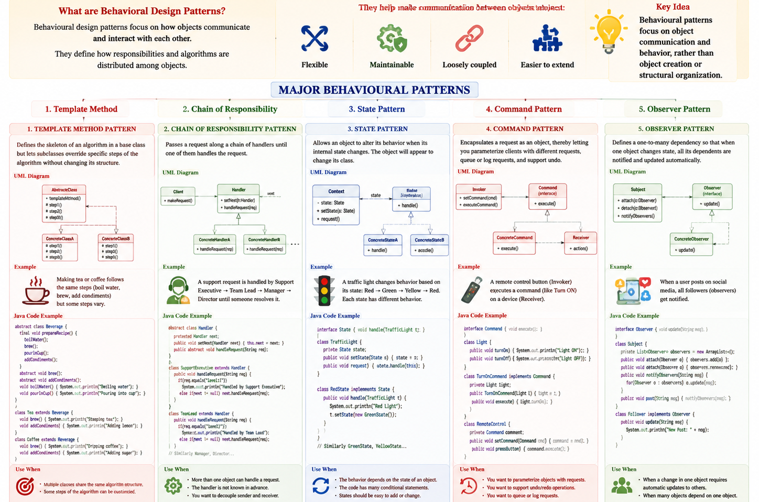
Module 2: Behavioural Design Patterns
What are Behavioral Design Patterns?
Behavioural design patterns focus on how objects communicate and interact with each other.
They define how responsibilities and algorithms are distributed among objects.
They help make communication between objects: Flexible; Maintainable; Loosely coupled; Easier to extend.
Major Behavioural Patterns:
  1. Template Method Pattern
  2. Chain of Responsibility Pattern
  3. State Pattern
  4. Command Pattern
  5. Observer Pattern
Key idea: Behavioural patterns focus on object communication and behavior, rather than object creation or structural organization.
1

Slide 5
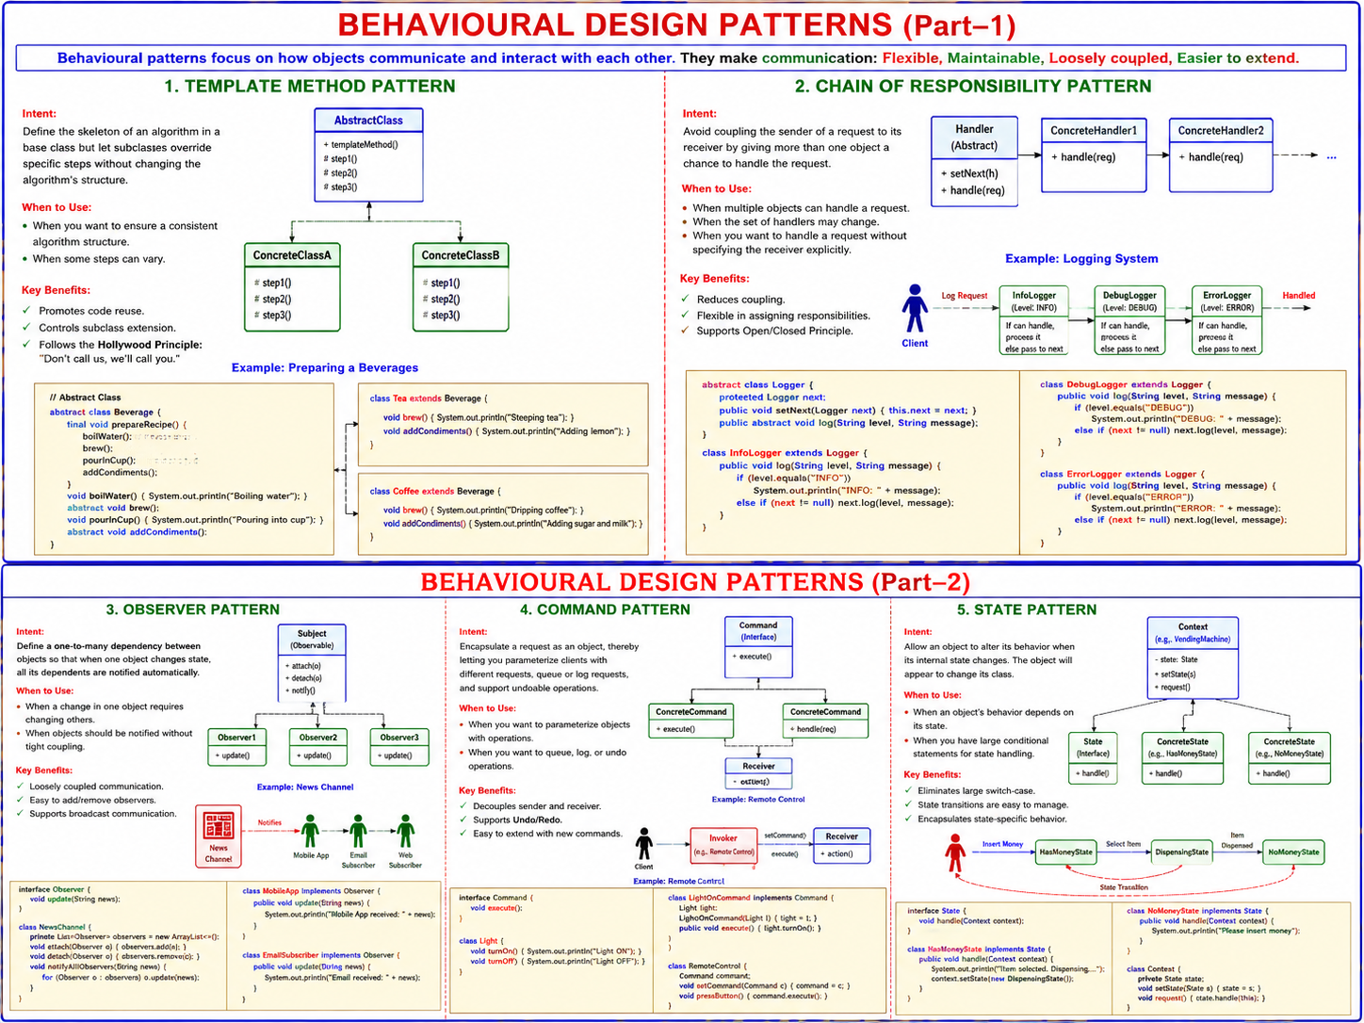
Module 2: Behavioural Design Patterns
What are Behavioral Design Patterns?
Behavioural design patterns focus on how objects communicate and interact with each other.
They define how responsibilities and algorithms are distributed among objects.
They help make communication between objects: Flexible; Maintainable; Loosely coupled; Easier to extend.
Major Behavioural Patterns:
  1. Template Method Pattern
  2. Chain of Responsibility Pattern
  3. State Pattern
  4. Command Pattern
  5. Observer Pattern
Key idea: Behavioural patterns focus on object communication and behavior, rather than object creation or structural organization.
1

Slide 6
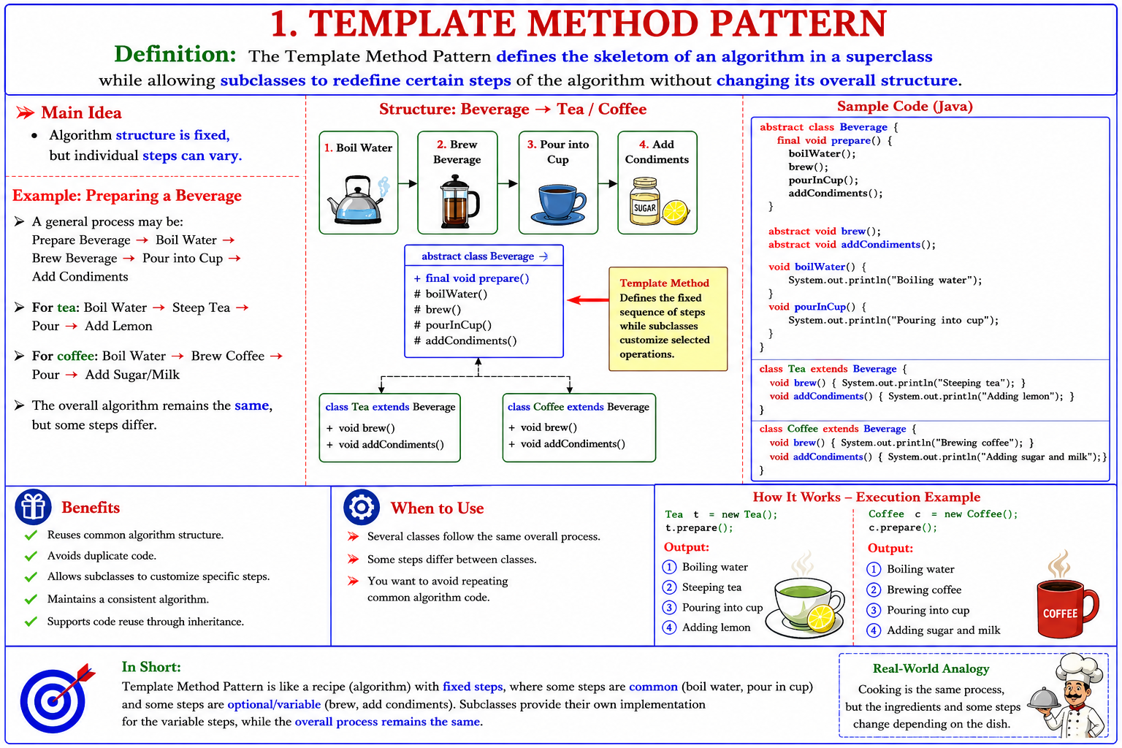

Slide 7
1. Template Method Pattern — Definition
The Template Method Pattern defines the skeleton of an algorithm in a superclass while allowing subclasses to redefine certain steps of the algorithm without changing its overall structure.
Main Idea: Algorithm structure is fixed, but individual steps can vary.
Example: Preparing a Beverage
A general process may be: Prepare Beverage → Boil Water → Brew Beverage → Pour into Cup → Add Condiments
For tea: Boil Water → Steep Tea → Pour → Add Lemon
For coffee: Boil Water → Brew Coffee → Pour → Add Sugar/Milk
The overall algorithm remains the same, but some steps differ.
2

Slide 8
Template Method Pattern — Structure and Benefits
Beverage
Tea
Coffee
Structure: Beverage → Tea / Coffee
Template Method: Defines the fixed sequence of steps while subclasses customize selected operations.
Benefits: Reuses common algorithm structure; Avoids duplicate code; Allows subclasses to customize specific steps; Maintains a consistent algorithm; Supports code reuse through inheritance.
When to Use: Several classes follow the same overall process; Some steps differ between classes; You want to avoid repeating common algorithm code.
3

Slide 9
Template Method Pattern — Java Example
abstract class Beverage {
final void prepare() {
boilWater();
brew();
pourInCup();
addCondiments();
}
abstract void brew();
abstract void addCondiments();
void boilWater() {
System.out.println("Boiling water");
}
void pourInCup() {
System.out.println("Pouring into cup");
}
}
4

Slide 10
2. Chain of Responsibility Pattern — Definition
The Chain of Responsibility Pattern passes a request through a chain of handlers until one handler can process the request.
Main Idea: Give multiple objects a chance to handle a request without coupling the sender to a specific receiver.
Example: University Complaint System: Student → Class Teacher → Department Chairman → Dean → Vice Chancellor
A complaint is passed along the chain until the appropriate authority handles it.
Basic Structure: Client → Handler A → Handler B → Handler C → Handler D
5

Slide 11
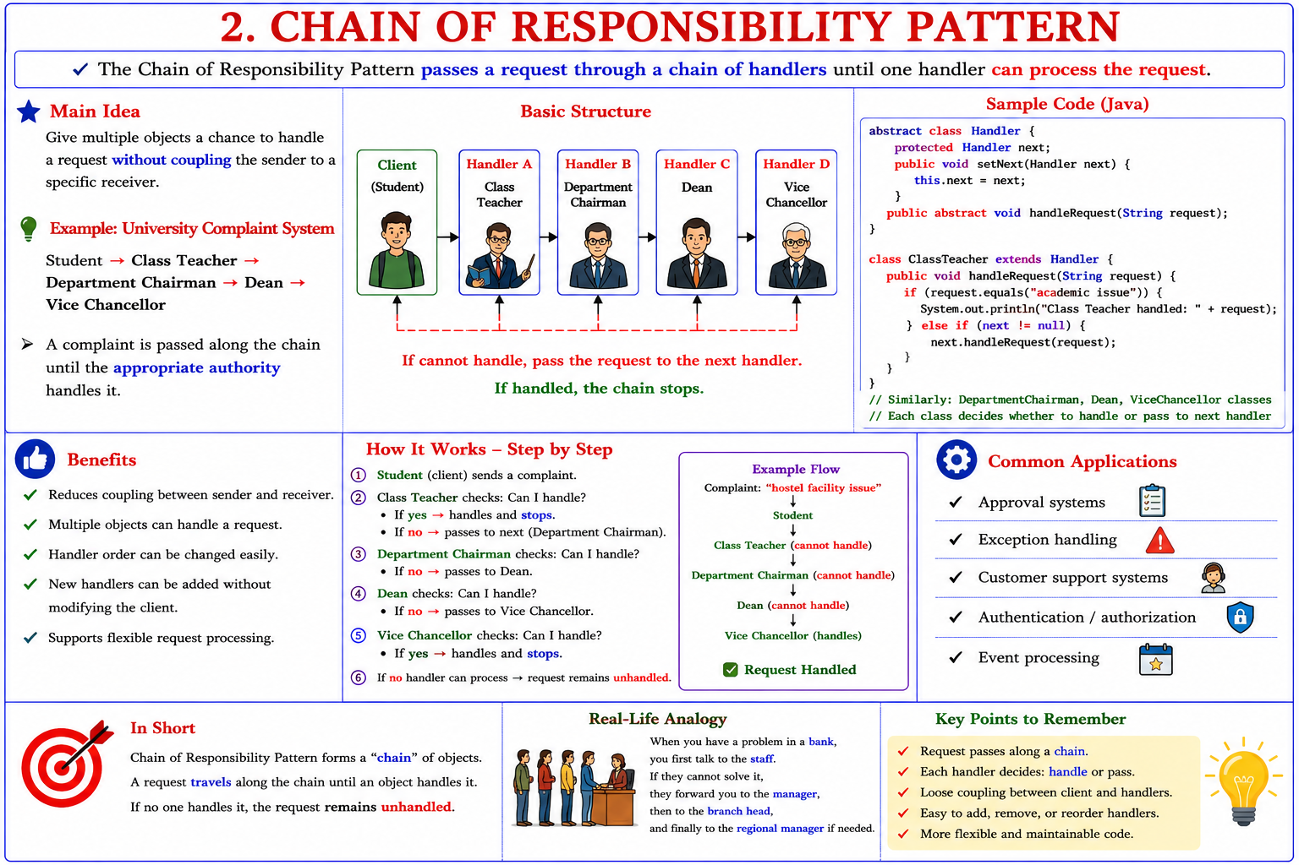
2. Chain of Responsibility Pattern — Definition
The Chain of Responsibility Pattern passes a request through a chain of handlers until one handler can process the request.
Main Idea: Give multiple objects a chance to handle a request without coupling the sender to a specific receiver.
Example: University Complaint System: Student → Class Teacher → Department Chairman → Dean → Vice Chancellor
A complaint is passed along the chain until the appropriate authority handles it.
Basic Structure: Client → Handler A → Handler B → Handler C → Handler D
5

Slide 12
Chain of Responsibility — Java Structure and Benefits
Benefits:
Reduces coupling between sender and receiver;
Multiple objects can handle a request;
Handler order can be changed easily;
New handlers can be added without modifying the client;
Supports flexible request processing.
Common Applications: Approval systems;
Exception handling; Customer support systems;
Authentication/authorization; Event processing.
6

Slide 13
3. State Pattern — Definition and Example
The State Pattern allows an object to change its behavior when its internal state changes.
Main Idea: The object appears to change its class when its state changes.
Example: Online Order
An order can have different states: Pending; Paid; Shipped; Delivered.
The behavior of the order depends on its current state.
Pending
Paid
Shipped
Delivered
7

Slide 14
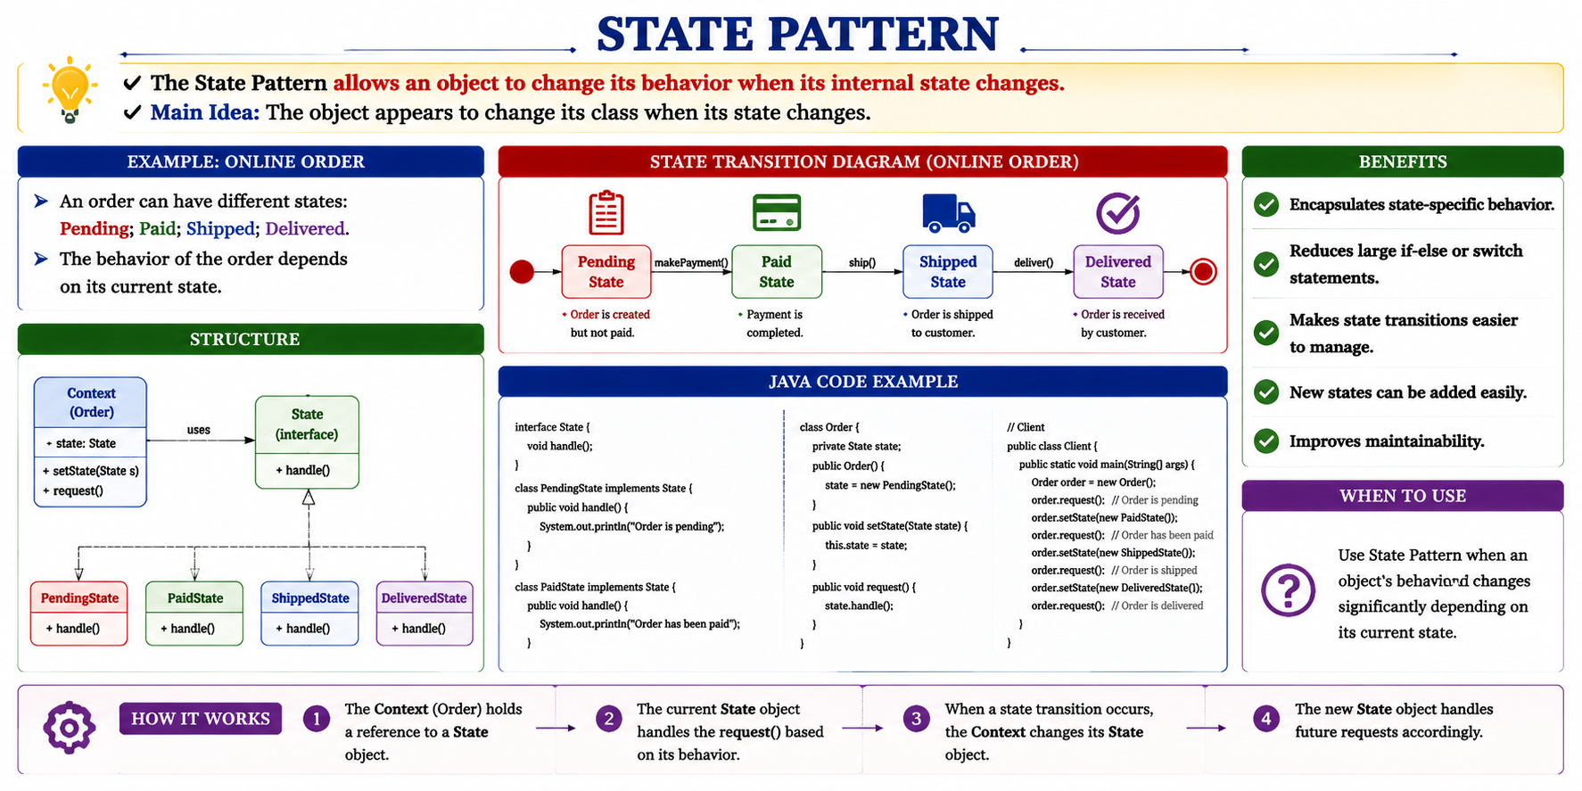
3. State Pattern — Definition and Example
The State Pattern allows an object to change its behavior when its internal state changes.
Main Idea: The object appears to change its class when its state changes.
Example: Online Order
An order can have different states: Pending; Paid; Shipped; Delivered.
The behavior of the order depends on its current state.
Pending
Paid
Shipped
Delivered
7

Slide 15
State Pattern — Structure and Benefits
Context
Pending State
Paid State
Shipped State
Structure: Context → Current State → Pending / Paid / Shipped
Benefits: Encapsulates state-specific behavior; Reduces large if-else or switch statements; Makes state transitions easier to manage; New states can be added easily; Improves maintainability.
When to Use: Use State Pattern when an object's behavior changes significantly depending on its current state.
8

Slide 16
State Pattern — Java Example
interface State {
void handle();
}
class PendingState implements State {
public void handle() {
System.out.println("Order is pending");
}
}
class PaidState implements State {
public void handle() {
System.out.println("Order has been paid");
}
}
9

Slide 17
4. Command Pattern — Definition
The Command Pattern encapsulates a request as an object.
This allows requests to be: Stored; Scheduled; Queued; Executed; Undone; Redone; Logged.
Main Components: Client/Sender → Command → Invoker → Receiver → Performs Task
Example: Text Editor: User → Paste Button → PasteCommand → Document
10

Slide 18
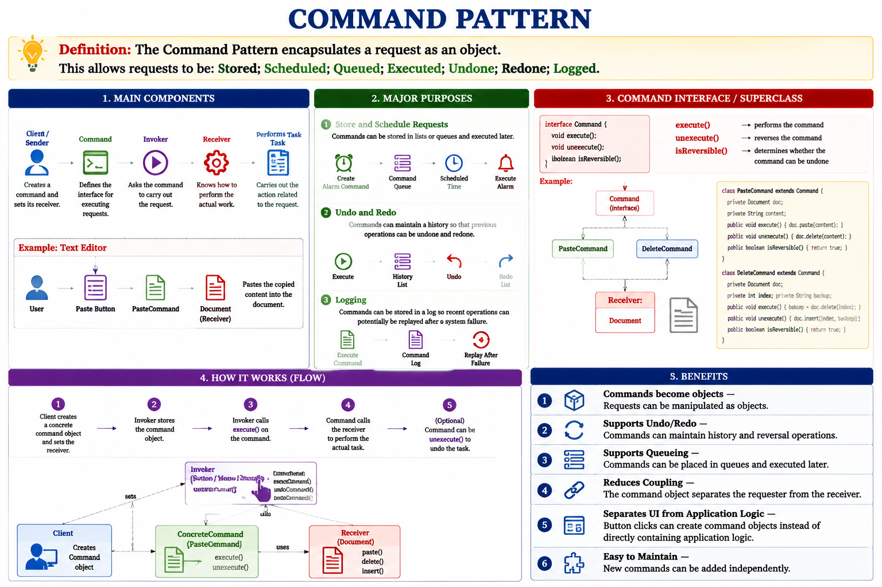
4. Command Pattern — Definition
The Command Pattern encapsulates a request as an object.
This allows requests to be: Stored; Scheduled; Queued; Executed; Undone; Redone; Logged.
Main Components: Client/Sender → Command → Invoker → Receiver → Performs Task
Example: Text Editor: User → Paste Button → PasteCommand → Document
10

Slide 19
Command Pattern — Purpose
Major Purposes
1. Store and Schedule Requests
Commands can be stored in lists or queues and executed later.
Example: Create Alarm Command → Command Queue → Scheduled Time → Execute Alarm
2. Undo and Redo
Execute → History List → Undo → Redo List
Commands can maintain a history so that previous operations can be undone and redone.
3. Logging
Commands can be stored in a log so recent operations can potentially be replayed after a system failure.
Client / Sender
Command
Invoker
Receiver
11

Slide 20
Command Pattern — Structure
Command Interface / Superclass
  execute() → performs the command
  unexecute() → reverses the command
  isReversible() → determines whether the command can be undone
Example: Command → PasteCommand / DeleteCommand → Receiver: Document
12

Slide 21
Command Pattern — Benefits
1. Commands become objects — Requests can be manipulated as objects.
2. Supports Undo/Redo — Commands can maintain history and reversal operations.
3. Supports Queueing — Commands can be placed in queues and executed later.
4. Reduces Coupling — The command object separates the requester from the receiver.
5. Separates UI from Application Logic — Button clicks can create command objects instead of directly containing application logic.
6. Easy to Maintain — New commands can be added independently.
Blog / Subject
Subscriber
Observer 1
Subscriber
Observer 2
Subscriber
Observer 3
13

Slide 22
5. Observer Pattern — Definition and Example
The Observer Pattern defines a one-to-many relationship in which a Subject maintains a list of Observers and automatically notifies them when its state changes.
Main Idea: One object changes → many dependent objects are notified.
Example: Blog Subscription: Blog (Subject) → Subscriber 1 / Subscriber 2 / Subscriber 3 (Observers)
When the blog changes: Blog Updated → notify() → update() on all subscribers.
interface Observer { void update(); }
Subject: registerObserver(); unregisterObserver(); notify();
14

Slide 23
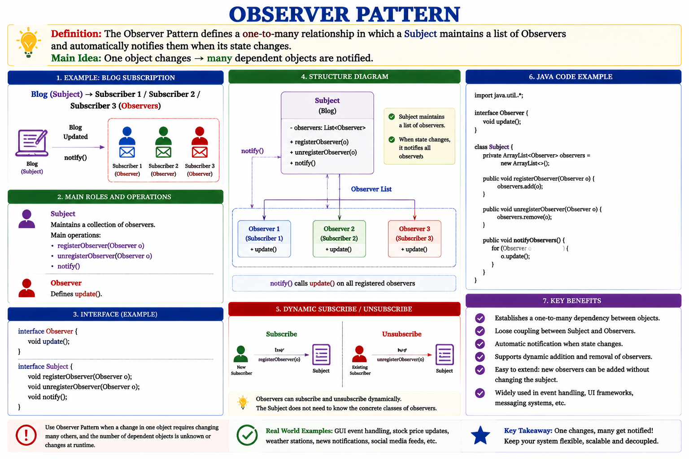
Observer Pattern — Java Example
class Subject {
private ArrayList<Observer> observers =
new ArrayList<>();
public void registerObserver(Observer o) {
observers.add(o);
}
public void unregisterObserver(Observer o) {
observers.remove(o);
}
public void notifyObservers() {
for (Observer o : observers) {
o.update();
}
}
}
16

Slide 24
Observer Pattern — Structure
Subject: Maintains a collection of observers.
Main operations: registerObserver(); unregisterObserver(); notify().
Observer: Defines update().
Structure: Subject → Observer List → notify() → Observer 1, Observer 2, Observer 3 → update()
Observers can subscribe and unsubscribe dynamically.
15

Slide 25
Observer Pattern — Java Example
class Subject {
private ArrayList<Observer> observers =
new ArrayList<>();
public void registerObserver(Observer o) {
observers.add(o);
}
public void unregisterObserver(Observer o) {
observers.remove(o);
}
public void notifyObservers() {
for (Observer o : observers) {
o.update();
}
}
}
16

Slide 26
Observer Pattern — Benefits & Applications
Benefits: Automatically notifies dependent objects; Reduces direct dependency between subject and observers; Supports one-to-many communication; Observers can subscribe/unsubscribe dynamically; Makes notification management easier; Useful when many objects depend on one object's state.
Applications: Blog/news subscriptions; GUI event handling; Notification systems; Stock-price monitoring; Weather monitoring; Real-time dashboards.
17

Slide 27
Comparison of Behavioural Patterns
Template Method → How an algorithm is performed (Same algorithm, variable steps)
Chain of Responsibility → Who will handle the request? (Handler chain)
State → What should I do in this state? (State-dependent behavior)
Command → Turn a request into an object (Request → Object)
Observer → Who needs to know about a change? (One-to-many notification)
18

Slide 28
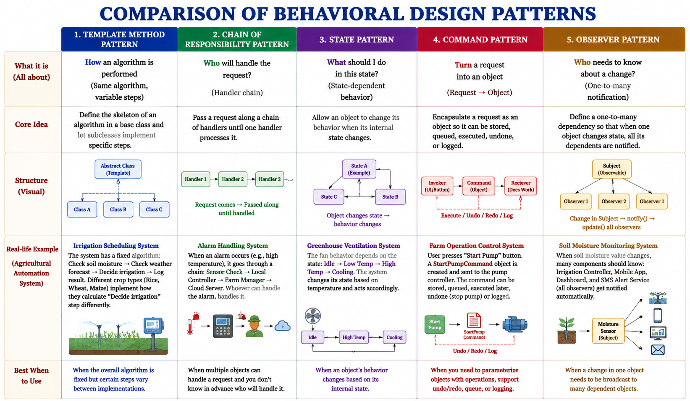
18

Slide 29
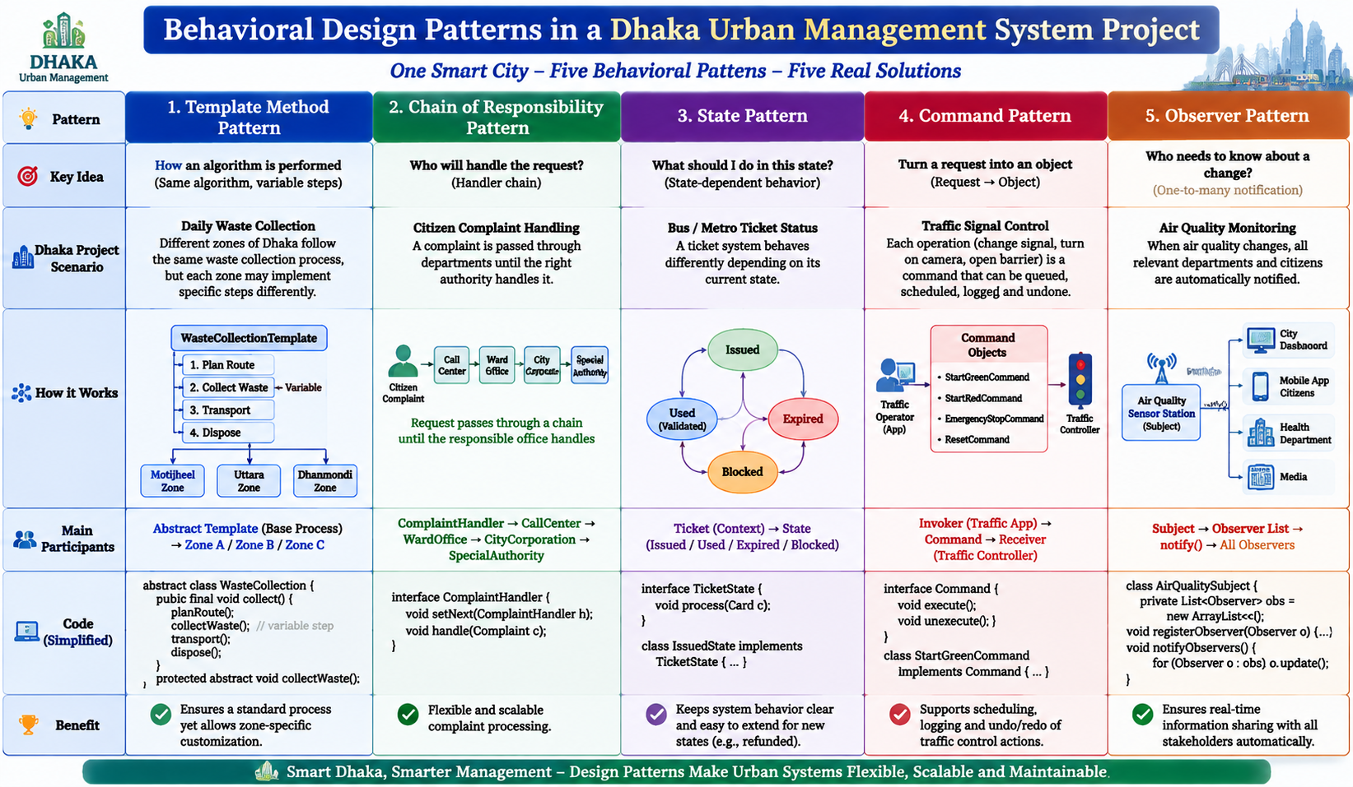
18

Slide 30
Problem Scenario
Suppose You are designing a system for money withdrawal from bank account using check with the following authorization scenario:
  For Tk. < 10,000 only cashier's authorization is sufficient to withdraw money from account.
  For Tk. 10,000 to 10,00,000 authorization from both cashier and senior officer is needed.
  For Tk > 10,00,000 authorization from Senior officer and Manager is needed.
  Implement this behaviour using appropriate software design pattern.
This Scenario is a classic example of the Chain of Responsibility Design Pattern.
The reason is:
A withdrawal request passes through a sequence of authorization levels.
Each authorization object decides whether it can handle the request.
If it cannot handle it, it forwards the request to the next authority.
The sender does not need to know which object will finally approve the request.
1. Concept
The Chain of Responsibility pattern creates a chain of handler objects. Each handler checks whether it can process a request; otherwise, it passes the request to the next handler in the chain.
In this bank withdrawal system:
Cashier | ↓ Senior Officer | ↓ Manager
19
Notes:
Exam Answer Summary
Appropriate Pattern: Chain of Responsibility Design Pattern
Reason:
The withdrawal request is passed through multiple authorization levels. Each authority decides whether it can approve the request; otherwise, it forwards the request to the next authority in the chain.
Participants:
Handler → Approver (abstract class)
Concrete Handlers → Cashier, Senior Officer, Manager
Client → Bank withdrawal system
This is the expected design pattern solution for this problem.

Slide 31
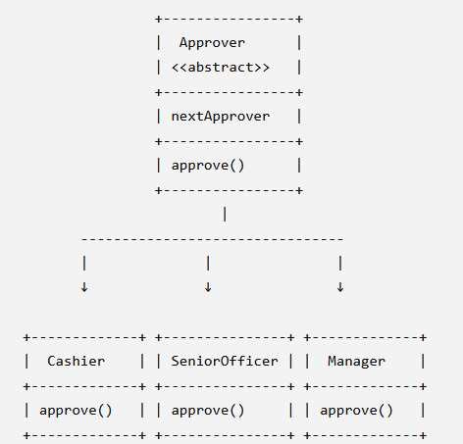
UML
Abstract Handler: abstract class Approver {
protected Approver nextApprover;
public void setNextApprover(Approver approver) {
this.nextApprover = approver; }
public abstract void approve(double amount);}
Cashier Class: class Cashier extends Approver{
public void approve(double amount){
if(amount < 10000){
System.out.println( "Cashier approved withdrawal of Tk. " + amount); } else if(nextApprover != null){
nextApprover.approve(amount); } }}
class SeniorOfficer extends Approver {
public void approve(double amount){
if(amount >= 10000 && amount <= 1000000){
System.out.println("Senior Officer approved withdrawal of Tk. " + amount); }
else if(nextApprover != null) { nextApprover.approve(amount); } }}
19

Slide 32
UML and Java Implementation
class Manager extends Approver {
public void approve(double amount) {
if(amount > 1000000){
System.out.println( "Manager approved withdrawal of Tk. " + amount); }
else {
System.out.println( "Withdrawal cannot be approved"); } }}
public class BankSystem {
public static void main(String args[]) {
Approver cashier = new Cashier(); Approver senior = new SeniorOfficer(); Approver manager = new Manager(); // Create chain cashier.setNextApprover(senior); senior.setNextApprover(manager); // Withdrawal requests cashier.approve(5000); cashier.approve(50000); cashier.approve(5000000); }}
Output: Cashier approved withdrawal of Tk. 5000Senior Officer approved withdrawal of Tk. 50000Manager approved withdrawal of Tk. 5000000
Real World Component | Design Pattern Component
Cashier | First Handler
Senior Officer | Second Handler
Manager | Final Handler
Withdrawal Request | Request Object
Authorization Process | Chain of Responsibility
19

Slide 33
UML and Java Implementation
Why Chain of Responsibility is Appropriate?
Flexible authorization flow
If the bank introduces another authority, for example:
Cashier | Senior Officer | Assistant Manager | Manager
we can add a new handler without modifying existing classes.
Loose coupling
The withdrawal request does not directly depend on Cashier, Senior Officer, or Manager.
Follows Open/Closed Principle
New approval levels can be added without changing existing code.
19
Notes:
Exam Answer Summary
Appropriate Pattern: Chain of Responsibility Design Pattern
Reason:
The withdrawal request is passed through multiple authorization levels. Each authority decides whether it can approve the request; otherwise, it forwards the request to the next authority in the chain.
Participants:
Handler → Approver (abstract class)
Concrete Handlers → Cashier, Senior Officer, Manager
Client → Bank withdrawal system
This is the expected design pattern solution for this problem.

Slide 34
Problem -2 Scenario
Question 1: Dhaka Urban Management System (DUMS)
Scenario: Smart Citizen Complaint Notification System
The Dhaka Urban Management System receives thousands of citizen complaints every day regarding waste collection, traffic problems, water supply, and emergency services.
When the status of a complaint changes, different users should automatically receive updates:
  Citizen receives complaint status notification.
  Department officer receives update information.
  City administrator receives monitoring alerts.
The complaint management system should notify all registered users automatically whenever the complaint status changes.
Requirement:
Implement this behavior using an appropriate software design pattern.
Design Pattern: Observer Pattern
Reason:
The Observer Pattern is suitable because:
  One object (Complaint) changes its state.
  Multiple dependent objects (Citizen, Officer, Administrator) need automatic updates.
  The complaint system should not tightly depend on specific notification users.
19
Notes:
Exam Answer Summary
Appropriate Pattern: Chain of Responsibility Design Pattern
Reason:
The withdrawal request is passed through multiple authorization levels. Each authority decides whether it can approve the request; otherwise, it forwards the request to the next authority in the chain.
Participants:
Handler → Approver (abstract class)
Concrete Handlers → Cashier, Senior Officer, Manager
Client → Bank withdrawal system
This is the expected design pattern solution for this problem.

Slide 35
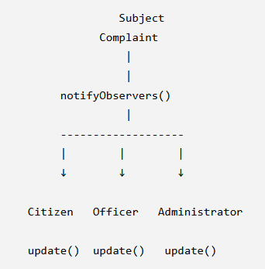
Problem -2 : UML and Java Implementation
Observer Interface
interface Observer {
void update(String message);}
Concrete Observer:
class Citizen implements Observer {
public void update(String message){
System.out.println( "Citizen Notification: " + message);
}}
class Officer implements Observer { public void update(String message){ System.out.println( "Officer Alert: " + message); }}
class Administrator implements Observer { public void update(String message){ System.out.println( "Admin Dashboard Update: " + message); }}
19
Notes:
Exam Answer Summary
Appropriate Pattern: Chain of Responsibility Design Pattern
Reason:
The withdrawal request is passed through multiple authorization levels. Each authority decides whether it can approve the request; otherwise, it forwards the request to the next authority in the chain.
Participants:
Handler → Approver (abstract class)
Concrete Handlers → Cashier, Senior Officer, Manager
Client → Bank withdrawal system
This is the expected design pattern solution for this problem.

Slide 36
Problem -2 : UML and Java Implementation
Subject Class
import java.util.*;
class Complaint {
ArrayList<Observer> observers =new ArrayList<>();
public void addObserver(Observer o){
observers.add(o);}
public void changeStatus(String status){ for(Observer o: observers){
o.update( "Complaint status changed to " + status); }}}
Citizen Notification:
Complaint status changed to CompletedOfficer Alert:
Complaint status changed to CompletedAdmin Dashboard Update:
Complaint status changed to Completed
Main Class
public class DUMS {
public static void main(String args[]){
Complaint complaint=new Complaint();
complaint.addObserver(new Citizen());
complaint.addObserver(new Officer());
complaint.addObserver(new Administrator());
complaint.changeStatus("Completed");}}
19
Notes:
Exam Answer Summary
Appropriate Pattern: Chain of Responsibility Design Pattern
Reason:
The withdrawal request is passed through multiple authorization levels. Each authority decides whether it can approve the request; otherwise, it forwards the request to the next authority in the chain.
Participants:
Handler → Approver (abstract class)
Concrete Handlers → Cashier, Senior Officer, Manager
Client → Bank withdrawal system
This is the expected design pattern solution for this problem.

Slide 37
Problem -3 Scenario
Question 2: Agricultural Automation System (AAS)
Scenario: Intelligent Irrigation Strategy Selection
An Agricultural Automation System controls irrigation based on different farming conditions.
The farmer can select different irrigation strategies:
Normal irrigation
Water-saving irrigation
Emergency irrigation during drought
The system should allow changing irrigation algorithms without modifying the main irrigation controller.
Requirement:
Implement this behavior using an appropriate software design pattern.
Solution
Design Pattern: Strategy Pattern
Reason:
Strategy Pattern is suitable because:
  Different irrigation algorithms exist.
  The algorithm can change dynamically.
  The irrigation controller does not need to know the internal implementation.
19
Notes:
Exam Answer Summary
Appropriate Pattern: Chain of Responsibility Design Pattern
Reason:
The withdrawal request is passed through multiple authorization levels. Each authority decides whether it can approve the request; otherwise, it forwards the request to the next authority in the chain.
Participants:
Handler → Approver (abstract class)
Concrete Handlers → Cashier, Senior Officer, Manager
Client → Bank withdrawal system
This is the expected design pattern solution for this problem.

Slide 38
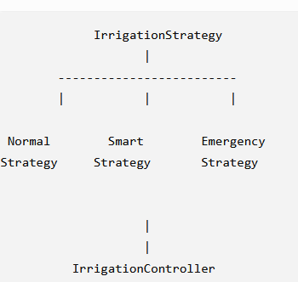
UML and Java Implementation for Scenario-3
interface IrrigationStrategy
{void irrigate();}
class NormalIrrigation implements IrrigationStrategy{
public void irrigate(){
System.out.println("Normal irrigation activated");}}
class WaterSavingIrrigationimplements IrrigationStrategy{public void irrigate(){System.out.println("Water saving irrigation activated");}}
class EmergencyIrrigationimplements IrrigationStrategy{public void irrigate(){System.out.println("Emergency irrigation activated");}}
19
Notes:
Exam Answer Summary
Appropriate Pattern: Chain of Responsibility Design Pattern
Reason:
The withdrawal request is passed through multiple authorization levels. Each authority decides whether it can approve the request; otherwise, it forwards the request to the next authority in the chain.
Participants:
Handler → Approver (abstract class)
Concrete Handlers → Cashier, Senior Officer, Manager
Client → Bank withdrawal system
This is the expected design pattern solution for this problem.

Slide 39
Problem - 3: UML and Java Implementation
Context class:
class IrrigationController{
private IrrigationStrategy strategy;
public void setStrategy(IrrigationStrategy strategy){this.strategy=strategy;}public void execute(){
strategy.irrigate();}}
Citizen Notification:
Water saving irrigation activatedEmergency irrigation activated
Main Class
public class FarmSystem{public static void main(String args[]){IrrigationController controller =new IrrigationController();controller.setStrategy(new WaterSavingIrrigation());controller.execute();controller.setStrategy(new EmergencyIrrigation());controller.execute();}}
19
Notes:
Exam Answer Summary
Appropriate Pattern: Chain of Responsibility Design Pattern
Reason:
The withdrawal request is passed through multiple authorization levels. Each authority decides whether it can approve the request; otherwise, it forwards the request to the next authority in the chain.
Participants:
Handler → Approver (abstract class)
Concrete Handlers → Cashier, Senior Officer, Manager
Client → Bank withdrawal system
This is the expected design pattern solution for this problem.

Slide 40
Problem -4 Scenario
Scenario: University Transport Approval System
A smart campus transportation system manages bus ticket approval.
Different transport requests require different approval levels:
Student transport request below 500 BDT → Transport Assistant approval
Request from 500 to 5000 BDT → Transport Manager approval
Request above 5000 BDT → University Administrator approval
The request should automatically move through the approval chain until the responsible authority handles it.
Requirement:
Implement this behavior using an appropriate software design pattern.
Solution
Design Pattern: Chain of Responsibility Pattern
Reason:
The Chain of Responsibility pattern is suitable because:
Multiple approval levels exist.
Each handler decides whether it can process the request.
The request moves to the next authority if required.
19
Notes:
Exam Answer Summary
Appropriate Pattern: Chain of Responsibility Design Pattern
Reason:
The withdrawal request is passed through multiple authorization levels. Each authority decides whether it can approve the request; otherwise, it forwards the request to the next authority in the chain.
Participants:
Handler → Approver (abstract class)
Concrete Handlers → Cashier, Senior Officer, Manager
Client → Bank withdrawal system
This is the expected design pattern solution for this problem.

Slide 41
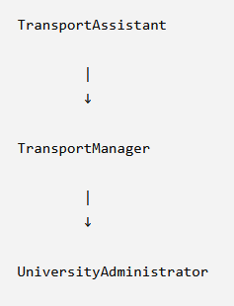
UML and Java Implementation for Scenario-4
abstract class Approver{protected Approver next;public void setNext(Approver next){this.next=next;}public abstract void approve(double amount);}
Transport Assistant:
class Assistant extends Approver{public void approve(double amount){if(amount<500){System.out.println("Assistant approved request");}else{next.approve(amount);}}}
Transport Manager:
class Manager extends Approver{public void approve(double amount){if(amount<=5000){System.out.println("Manager approved request");}else{next.approve(amount);}}}
19
Notes:
Exam Answer Summary
Appropriate Pattern: Chain of Responsibility Design Pattern
Reason:
The withdrawal request is passed through multiple authorization levels. Each authority decides whether it can approve the request; otherwise, it forwards the request to the next authority in the chain.
Participants:
Handler → Approver (abstract class)
Concrete Handlers → Cashier, Senior Officer, Manager
Client → Bank withdrawal system
This is the expected design pattern solution for this problem.

Slide 42
UML and Java Implementation for Scenario-4
Adminstrator:
class Administrator extends Approver{public void approve(double amount){System.out.println("Administrator approved request");}}
Main:
public class CampusTransport{public static void main(String args[]){Approver assistant=new Assistant();Approver manager=new Manager();Approver admin=new Administrator();assistant.setNext(manager);manager.setNext(admin);assistant.approve(7000);}}
Output:
Administrator approved request
19
Notes:
Exam Answer Summary
Appropriate Pattern: Chain of Responsibility Design Pattern
Reason:
The withdrawal request is passed through multiple authorization levels. Each authority decides whether it can approve the request; otherwise, it forwards the request to the next authority in the chain.
Participants:
Handler → Approver (abstract class)
Concrete Handlers → Cashier, Senior Officer, Manager
Client → Bank withdrawal system
This is the expected design pattern solution for this problem.

Slide 43
System | Scenario | Behavioral Pattern
Dhaka Urban Management System | Complaint status notification | Observer Pattern
Agricultural Automation System | Irrigation algorithm selection | Strategy Pattern
Smart Campus Transportation System | Transport approval workflow | Chain of Responsibility Pattern
These three questions together cover three major behavioral patterns:
Observer → Object communication
Strategy → Algorithm selection
Chain of Responsibility → Request processing workflow
They are appropriate for an Object-Oriented Design Pattern Lab exam because students can identify the pattern from the real-world scenario and implement it using Java.
Notes:
Exam Answer Summary
Appropriate Pattern: Chain of Responsibility Design Pattern
Reason:
The withdrawal request is passed through multiple authorization levels. Each authority decides whether it can approve the request; otherwise, it forwards the request to the next authority in the chain.
Participants:
Handler → Approver (abstract class)
Concrete Handlers → Cashier, Senior Officer, Manager
Client → Bank withdrawal system
This is the expected design pattern solution for this problem.

Slide 44
Other Pattern Scenario
Observer Patttern Scenario:
In the Dhaka Urban Management System, citizens can submit complaints regarding waste collection, traffic problems, water supply, and emergency services.
Whenever the complaint status changes (e.g., Submitted → Processing → Completed), multiple users should automatically receive updates:
Citizen receives notification about complaint progress.
Responsible department officer receives task updates.
City administrator receives monitoring information.
The complaint management system should notify all registered users automatically without modifying the complaint class whenever a new type of user is added.
Requirement:
What problem does the Observer Design Pattern solve? Explain how the Observer Pattern can be applied in the Dhaka Urban Management System. Draw the supporting UML diagram and implement the solution.
Expected Pattern: Observer Pattern
Concept:
One object (Subject) maintains a list of dependent objects (Observers) and automatically notifies them when its state changes.
19

Slide 45
Other Pattern Scenario
Strategy Pattern
Agricultural Automation System (AAS)
Scenario:An Agricultural Automation System controls irrigation based on different farming conditions.The irrigation controller supports different irrigation strategies:Normal irrigation during regular weather conditions.Water-saving irrigation during water shortage.Emergency irrigation during drought situations.The system should allow farmers to change the irrigation strategy dynamically without modifying the irrigation controller code.Requirement:What problem does the Strategy Design Pattern solve? Explain how the Strategy Pattern can be used for dynamic irrigation decision-making in the Agricultural Automation System. Draw the supporting UML diagram and implement the solution.
Expected Pattern:Strategy Pattern
Concept:Encapsulates different algorithms and allows them to be exchanged at runtime.
19

Slide 46
Other Pattern Scenario
Command Pattern
Smart Food Management System
Scenario:A Smart Food Management System provides an online food ordering service.Customers can perform different actions:Place food order.Cancel order.Modify order.Track delivery.The system should store customer requests so that previous operations can be logged, cancelled, or executed later.The ordering system should allow different commands without directly coupling the customer interface with restaurant operations.Requirement:What problem does the Command Design Pattern solve? Explain how the Command Pattern can be applied in the Smart Food Management System for handling customer orders. Draw the supporting UML diagram and implement the solution.
Expected Pattern:Command Pattern
Concept:Encapsulates a request as an object, allowing operations to be stored, queued, logged, or undone.
19

Slide 47
Other Pattern Scenario
State Pattern
Smart Traffic Management System (DUMS Module)
Scenario:A Smart Traffic Management System controls traffic signals at different road intersections.A traffic signal changes its behavior depending on its current state:Green State → Allow vehicles to move.Yellow State → Prepare vehicles to stop.Red State → Stop vehicles.The behavior of the traffic light should change automatically when its internal state changes without using complex conditional statements.Requirement:What problem does the State Design Pattern solve? Explain how the State Pattern can be used to model traffic signal behavior in the Smart Traffic Management System. Draw the supporting UML diagram and implement the solution.
Expected Pattern:State Pattern
Concept:Allows an object to change its behavior when its internal state changes.
19

Slide 48
Other Pattern Scenario
Adapter Pattern
Agricultural Automation System
Scenario:A Smart Agricultural Automation System uses an existing irrigation controller that accepts data from a standard soil moisture sensor.A newly purchased IoT soil sensor provides moisture information using a different interface. The existing irrigation controller cannot directly communicate with this new sensor.
Requirement:What problem does the Adapter Design Pattern solve? Explain how the Adapter Pattern can integrate the new IoT soil sensor without modifying the existing irrigation controller. Draw the supporting UML diagram and implement the solution.
19

Slide 49
Sample Question
What problem does Adapter design pattern solve? Explain with an example and draw supporting UML diagram.
Suppose You are designing a system for money withdrawal from bank account using check with the following authorization scenario:
For Tk. < 10,000 only cashier's authorization is sufficient to withdraw money from account.
For Tk. 10,000 to 10,00,000 authorization from both cashier and senior officer is needed.
For Tk > 10,00,000 authorization from Senior officer and Manager is needed.
Implement this behaviour using appropriate software design pattern.
19

Slide 50
Sample Quesiton
Bloom's Level | Question
Remember | 1. What is a behavioural design pattern? Name five behavioural patterns discussed in Module 2.
Understand | 2. Explain the main purpose of the Template Method Pattern.
Understand | 3. Explain how the Chain of Responsibility Pattern processes a request through multiple handlers.
Apply | 4. Design a university complaint-handling process using the Chain of Responsibility Pattern, where complaints may be handled by a Class Teacher, Department Chairman, Dean, or Vice Chancellor.
Analyze | 5. Analyze a program containing a large number of if-else statements to determine an object's behavior based on its current state. Explain how the State Pattern could improve the design.
Evaluate | 6. Evaluate the advantages and disadvantages of using the State Pattern instead of a large switch statement.
Create | 7. Design a Java-based online order system using the State Pattern with Pending, Paid, Shipped, and Delivered states.
Bloom's Level | Question
Remember | 1. Define the Command Pattern and identify its main components.
Understand | 2. Explain the purpose of the Command Pattern and how it encapsulates a request as an object.
Understand | 3. Explain how the Command Pattern can support undo and redo operations.
Apply | 4. Apply the Command Pattern to a text editor that supports Copy, Paste, Delete, and Undo operations. Identify the Command, Invoker, and Receiver.
Analyze | 5. Analyze how the Command Pattern reduces coupling between a graphical user-interface button and the object that performs the actual operation.
Evaluate | 6. Evaluate the benefits of using the Command Pattern for queueing, logging, scheduling, and undo/redo operations.
Create | 7. Design a Java-based remote-control system using the Command Pattern where different buttons can execute different commands such as LightOn, LightOff, and FanOn.
Bloom's Level | Question
Remember | 1. Define the Command Pattern and identify its main components.
Understand | 2. Explain the purpose of the Command Pattern and how it encapsulates a request as an object.
Understand | 3. Explain how the Command Pattern can support undo and redo operations.
Apply | 4. Apply the Command Pattern to a text editor that supports Copy, Paste, Delete, and Undo operations. Identify the Command, Invoker, and Receiver.
Analyze | 5. Analyze how the Command Pattern reduces coupling between a graphical user-interface button and the object that performs the actual operation.
Evaluate | 6. Evaluate the benefits of using the Command Pattern for queueing, logging, scheduling, and undo/redo operations.
Create | 7. Design a Java-based remote-control system using the Command Pattern where different buttons can execute different commands such as LightOn, LightOff, and FanOn.
19

Slide 51
Sample Quesiton
Bloom's Level | Question
Remember | 1. Name five behavioural design patterns discussed in Module 2.
Understand | 2. Explain the main idea of the Template Method Pattern.
Understand | 3. Explain why the Chain of Responsibility Pattern reduces coupling between a request sender and request receiver.
Apply | 4. A university has several levels of approval: Teacher → Chairman → Dean → Vice Chancellor. Apply the Chain of Responsibility Pattern to this approval system.
Analyze | 5. Analyze a program where an object's behavior is controlled by a large switch statement based on its current state. Identify the problem and explain how the State Pattern could improve it.
Evaluate | 6. Evaluate the advantages and disadvantages of using the Chain of Responsibility Pattern when many handlers are present in the chain.
Create | 7. Design a Java-based customer-support system using the Chain of Responsibility Pattern with different support levels such as Level 1, Level 2, and Level 3 support.
Bloom's Level | Question
Remember | 1. What is the Command Pattern? Name its major participants.
Understand | 2. Explain how the Command Pattern encapsulates a request as an object.
Understand | 3. Explain how the Command Pattern can support command queueing and scheduling.
Apply | 4. Apply the Command Pattern to a text editor that provides Copy, Paste, Delete, and Undo operations. Identify the Client, Command, Invoker, and Receiver.
Analyze | 5. Analyze a GUI application in which every button directly contains the application logic for performing its operation. Explain the coupling problem and how the Command Pattern can solve it.
Evaluate | 6. Evaluate whether the Command Pattern is appropriate for implementing an undo/redo mechanism. Explain your reasoning.
Create | 7. Create a Java-based restaurant ordering system using the Command Pattern where orders can be created, queued, executed, and cancelled.
Bloom's Level | Question
Remember | 1. Define the Observer Pattern and identify the Subject and Observer.
Understand | 2. Explain the one-to-many relationship used by the Observer Pattern.
Understand | 3. Explain how the Observer Pattern reduces direct dependency between a subject and its dependent objects.
Apply | 4. Apply the Observer Pattern to an online news system where multiple users receive notifications whenever a new article is published.
Analyze | 5. Analyze a weather-monitoring system where the weather station directly calls update methods on every display component. Explain the design problems and suggest how the Observer Pattern could improve the system.
Evaluate | 6. Compare the Observer Pattern with manually notifying every dependent object. Evaluate the advantages of using the Observer Pattern.
Create | 7. Design a Java-based stock-price monitoring system using the Observer Pattern. Include a StockMarket Subject and at least three different Observer classes.
19

